Slide 1
Public support to organic certification

Slide 2
Political justification for supporting organic certification

Slide 3
Certification as a public good
Certification is there to correct a market imperfection: the asymmetry of information between seller and buyer. Optimizes market functioning in a free market economy.
Control is often a duty of the state, e.g. food safety control. Organic control can also be the role of a government (partly delegated to private Certification Bodies (CB)).
Covering certification costs can give equal access to certification for operators all over the territory (remote areas) and for all farming systems (diversified production).
Presence and outreach of organic certifiers is a strong factor in organic sector growth.

Slide 4
Possible ways to support organic input certification

Slide 5
Different models of support
Set-up a national certification body financed through the regular public budget (certification free of charge for all national organic operators). E.g. Denmark.
Set-up national certification body providing only local certification, at reduced costs. E.g. Lao PDR.
Support the national CB to get international accreditation (e.g. IFOAM Accreditation). E.g. Czech Republic.
Subsidies for organic certification (e.g.: US cost-share program, Tunisia, many Chinese local governments) or full reimbursement (e.g.: Philippines, Samoa).
Subsidies for food quality scheme certification in general (e.g. EU)
Support conversion projects or setting-up Internal Control Systems (ICS) for group certification (e.g. Indonesia).

Slide 6
Country examples

Slide 7
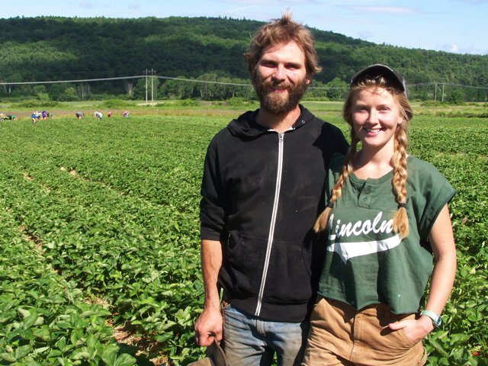
US National Organic Certification Cost Share Program
Support to Organic Agriculture (OA) certification is the main form of support to OA in the US.
NOCCSP and AMA reimburse up to 75% of the annual certification costs with maximum of EUR 697 per farm.
Federal budget allocates EUR 9.5 million annually as mandatory funding for certification cost-share.
Administered at the state level.
Notes:
NOCCSP: The National Organic Certification Cost Share Program
AMA: Agricultural Management Assistance Organic Certification Cost Share Program
These are noncompetitive financial assistance programs that help defray the costs of organic certification for organic farmers.

Slide 8
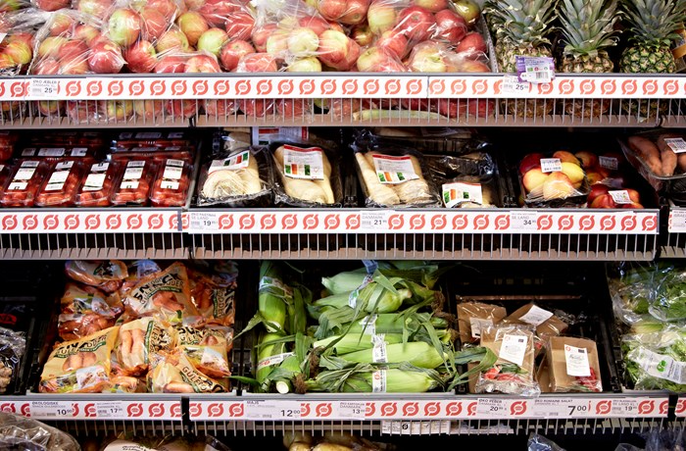
Denmark: free public certification for all
First law on organic farming voted in 1998 established the public organic certification system for all operators. Followed by spectacular sector growth.
Free of charge for all, including farmers, processors, handlers.
Responsible agencies are the Danish Agrifish Agency and the Danish Veterinary and Food Agency. 10 regional control and enforcement offices.
Notes:
Exceptions to the “free of charge” policy:
• Extra controls due to risk of fraud;
• Certification for exporting to other regulating countries not covered by equivalence arrangements;
• Certification to private standards that are demanded by certain EU markets.

Slide 9
The Philippines, Tunisia, Mexico
Law in The Philippines provides full organic certification cost reimbursement for the first 3 years. Payment is done directly by the Department of Ag regional field office to the chosen CB.
In Tunisia, organic certification is subsidized since 1999. Subsidy covers 70% of the certification costs for a period of 5 to 7 years.
Mexico: federal government reimburses:
50% of capacity building costs to obtain OA certification,
50-75% of the technical assistance costs for operators to produce their Organic System Plan, and
50-75% of the certification costs.
Plus it supports organic CBs by covering 50% of their organic accreditation costs.

Slide 10
Pitfalls and challenges of this form of support

Slide 11
Main challenges
Main challenge of subsidies/reimbursement: Complicated reimbursement procedures can make access difficult for small operators.
Challenges of the public certification model:
Cannot work in countries with low cultural trust in government or high corruption.
Needs to have the right competence (e.g. to obtain international accreditation).
Risk that not enough resources are allocated, so unable to reach all operators (e.g. Costa Rica).
Might not be able to provide all options required by the market (e.g. private scheme OA certification, certification to other regulations, etc.)

Slide 12
Thank you for your attention!
Complete policy toolkit available at www.ifoam.bio

